Slide 1
Leveraging Machine Learning for Early Prediction of Lifestyle Diseases: A Data-Driven Approach
PIP104 PROFESSIONAL PRACTICE-II
VIVA-VOCE
Batch Number: CBC-G03
Roll Number | Student Name
20201CBC0004 | SUKRUTHI RAO
20201CBC0008 | S HARISH
20201CBD0024 | R SAISARAN
Under the Supervision of,
Dr.Srinivasan T R - Professor
School of Computer Science & Engineering
Presidency University
Project Guide : B.Pakruddin - Assistant Professor
School of Computer Science & Engineering
Presidency University

Slide 2
Introduction
Problem Statement-MHRD – IIC
Early prediction of lifestyle diseases - How can we predict the likelihood of lifestyle
diseases early to enable preventive healthcare. This can reduce the cost of treatment significantly.
Lifestyle diseases, such as diabetes, cardiovascular diseases, and obesity, have become a global health concern due to their increasing prevalence and the associated healthcare costs. Early prediction of these diseases is crucial for enabling preventive healthcare measures, which can substantially reduce treatment expenses. This project aims to develop a predictive model that leverages various data sources to estimate an individual's likelihood of developing lifestyle diseases in the future. By identifying high-risk individuals early, we can empower them with personalized interventions and lifestyle modifications to mitigate disease onset and progression.

Slide 3
Literature Review
Year, Name of the Journal/Conference | Title of the paper | Authors of the paper | Methods/Algorithms/ Techniques used | Merits | Demerits
2023 7th International Conference on Computing Methodologies and Communication (ICCMC) | Comparison and Analysis of Various Machine Learning Algorithms for Disease Prediction | S. Kanamarlapudi, V. S. Yakkala, B. Gayathri, K. V. Nusimala, S. S. Aravinth and S. S | Decision Tree,K-Nearest Neighbors (KNN),Logistic Regression | Simple and interpretable models for non-linear relationships in classification and regression. | Sensitive to the choice of hyperparameters and overfit the data
2018 International Conference on Smart City and Emerging Technology (ICSCET) | Analysis and Prediction of health issues for teaching profession using Semantic Techniques | C. I. Arthi, R. L. Priya and R. Rautela | First Order Logic,Description Logic | The proposed method can predict many health problems, both common and those caused by work. | The proposed method needs a lot of data to train the models, and it is complex and requires expertise in semantic technologies.
2022 5th International Conference on Advances in Science and Technology (ICAST) | DiseaseLens: A Lifestyle related Disease Predictor | A. Parab, P. Gholap and V. Patankar | Decision tree algorithm | Decision trees can predict lifestyle-related diseases accurately because they are good at learning complex relationships. | Decision trees can memorize the training data, but pruning and cross-validation can help them generalize to new data
2021 International Conference on Computing, Communication and Green Engineering (CCGE) | A Machine Learning based Model for Disease Prediction | M. Gulhane and T. Sajana | Naive Bayes, K-Nearest Neighbors (KNN), Decision Trees, Random Forest, and Support Vector Machines (SVM). | The AI model can predict diseases with over 90% accuracy and can handle large sets of medical records. | The model is hard to understand, so it's hard to know what causes the model to predict disease.
2023 5th International Conference on Smart Systems and Inventive Technology (ICSSIT) | Machine Learning Algorithms for Disease Prediction Analysis | M. Govindaraj, V. Asha, B. Saju, M. Sagar and Rahul | Decision Tree,Random Forest,Logistic Regression | More accurate and robust than individual decision trees, and can handle high-dimensional data. | Machine learning algorithms can be difficult to use, as they require careful selection of features and may not be accurate for complex problems.

Slide 4
Research Gaps Identified
Feature Set Enhancement: Limited input features for disease prediction models.
Advanced Model Exploration:Investigate deep learning architectures to capture intricate nonlinear relationships in medical data, addressing challenges of complexity and data size is difficult.
Rigorous Model Evaluation: Lack of detailed model evaluation.
Model Interpretability Integration: Absence of features providing insights into predictions.

Slide 5
Proposed Methodology
Our approach involves developing a comprehensive predictive model that combines medical history, genetic information, lifestyle choices, and real-time health monitoring. The model will employ artificial intelligence and advanced machine learning techniques, such as deep learning and ensemble methods, to analyze large datasets. Artificial intelligence can be used to interpret the predictions and provide personalized recommendations for risk reduction. We will also incorporate data from wearable devices and mobile applications to provide continuous health monitoring and early warning alerts. Additionally, a user-friendly interface will be created to facilitate easy access to health information and personalized recommendations.

Slide 6
Objectives
The objective of early prediction of lifestyle diseases is to identify individuals who are at high risk of developing a particular disease, so that preventive measures can be taken to reduce their risk.
To develop a machine learning-based model for early prediction of lifestyle diseases using demographic and vital statistics.
To evaluate the effectiveness of the model in terms of accuracy, sensitivity, and specificity.
To explore the potential impact of early disease prediction on healthcare costs and patient outcomes.

Slide 7
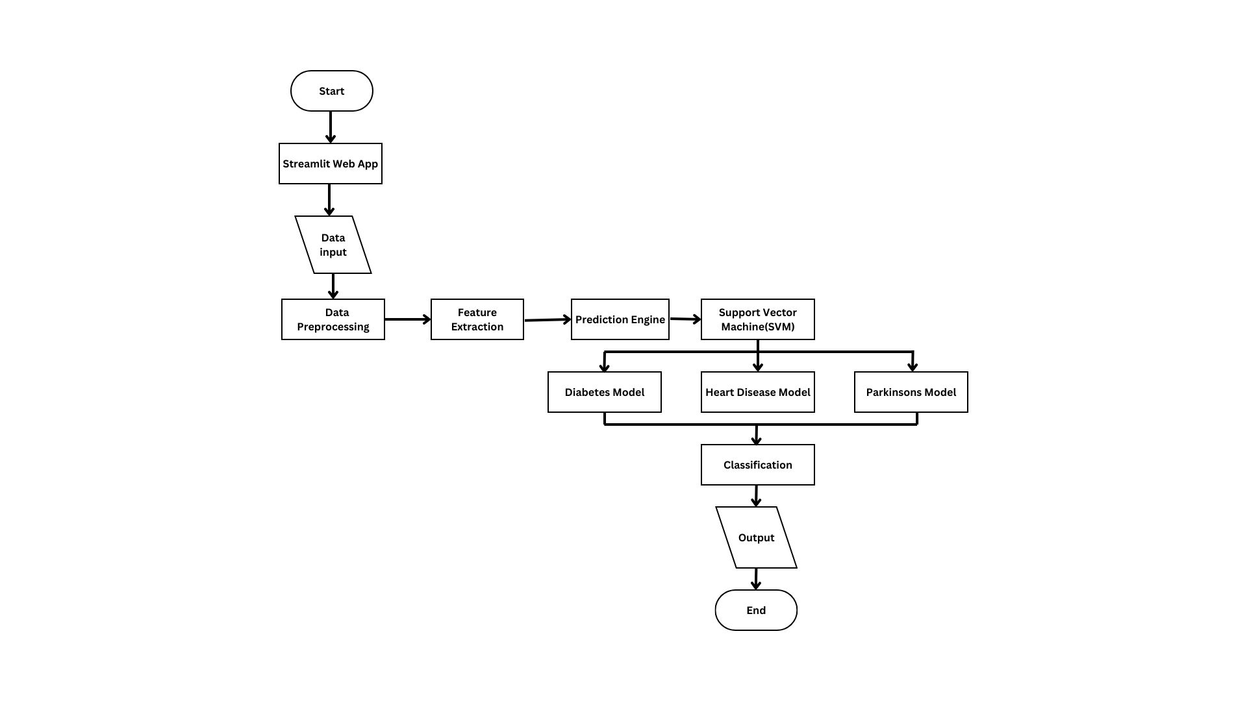
System Design

Slide 8
Implementation
Objective:
Predict diabetes, heart disease, and Parkinson's disease using machine learning.
Technology Stack:
Streamlit (Python web application framework)
Machine learning models loaded using pickle
Application Flow:
Sidebar navigation for disease selection
Input forms for user data
Integration with pre-trained ML models
Display of prediction results using st.success
Models:
Three models loaded: Diabetes, Heart Disease, Parkinson's Disease
Input Validation:
Assumes valid input; minimal validation for brevity

Slide 9
Timeline of Project
TASK | START DATE | END DATE | DURATION
Project Initiation | Oct 1,2023​ | Oct 14,2023 | 14 days​
Planning | Oct 15,2023 | Oct 31,2023​ | 17 days​
Data Collection & Preprocessing | Nov 1,2023​ | Nov 15,2023​ | 15 days​
Feature Engineering & Model Development | Nov 16,2023​ | Nov 30,2023​ | 15 days​
Continuous Monitoring​ | Dec 1,2023​ | Dec 14,2023 | 14 days​
UI Development, Validation & Testing | Dec 15,2023​ | Dec 30,2023​ | 16 days​
Closure | Jan 1,2024​ | Jan 8,2024​ | 8 days​

Slide 10
Outcomes
This project will yield a highly accurate and scalable predictive model for lifestyle diseases. The outcomes include:
Early identification of individuals at high risk of lifestyle diseases.
Personalized recommendations for lifestyle modifications and preventive measures.
Reduction in healthcare costs by preventing disease onset and progression.
Improved overall health and quality of life for individuals.

Slide 11
Conclusion
Early prediction of lifestyle diseases through advanced predictive modeling and real-time health monitoring is a promising approach to reduce healthcare costs and improve public health. By leveraging diverse data sources and cutting-edge machine learning techniques, we aim to create a powerful tool for preventive healthcare.

Slide 12
References
[1] A. Chanchal, A. S. Singh and K. Anandhan, "A Modern Comparison of ML Algorithms for Cardiovascular Disease Prediction," 2021 9th International Conference on Reliability, Infocom Technologies and Optimization (Trends and Future Directions) (ICRITO), Noida, India, 2021, pp. 1-5, doi: 10.1109/ICRITO51393.2021.9596228.
[2] G. G. Warsi, S. Saini and K. Khatri, "Ensemble Learning on Diabetes Data Set and Early Diabetes Prediction," 2019 International Conference on Computing, Power and Communication Technologies (GUCON), New Delhi, India, 2019, pp. 182-187.
[3] A. H. Neehal, M. N. Azam, M. S. Islam, M. I. Hossain and M. Z. Parvez, "Prediction of Parkinson's Disease by Analyzing fMRI Data and using Supervised Learning," 2020 IEEE Region 10 Symposium (TENSYMP), Dhaka, Bangladesh, 2020, pp. 362-365, doi: 10.1109/TENSYMP50017.2020.9230918.
[4] M. A. Shaik, R. Sreeja, S. Zainab, P. S. Sowmya, T. Akshay and S. Sindhu, "Improving Accuracy of Heart Disease Prediction through Machine Learning Algorithms," 2023 International Conference on Innovative Data Communication Technologies and Application (ICIDCA), Uttarakhand, India, 2023, pp. 41-46, doi: 10.1109/ICIDCA56705.2023.10100244.
[5] S. Samet, M. R. Laouar and I. Bendib, "Use of Machine Learning Techniques to Predict Diabetes at an Early Stage," 2021 International Conference on Networking and Advanced Systems (ICNAS), Annaba, Algeria, 2021, pp. 1-6, doi: 10.1109/ICNAS53565.2021.9628903.

Slide 13
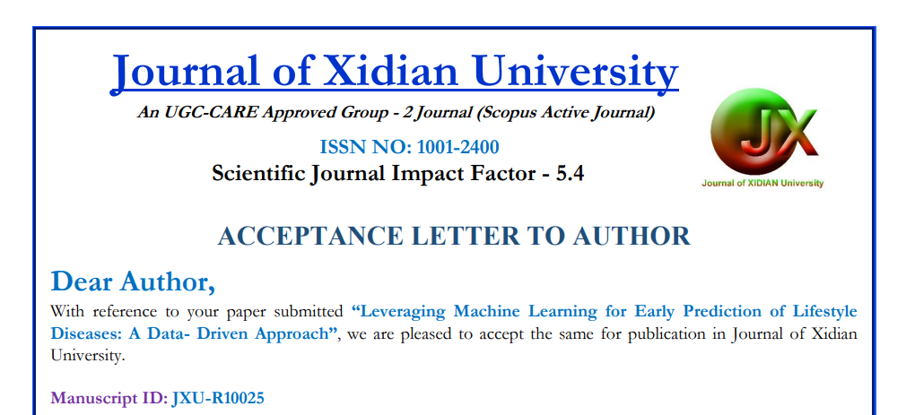
Publication Details
UGC CARE GROUP - 2 JOURNAL - Journal of Xidian University: Volume 18, Issue 1, 2024
Manuscript ID(s) : JXU-R10025

Slide 14

Thank You

